Slide 1
Econ 100 Principles of Economics
Lecture 9
March 27

Slide 2
Today:
Demand
- then supply
- later: price mechanism and equilibrium analysis via demand&supply

Slide 3
Please turn off your phones and other devices.

Slide 4
DEMAND

Slide 5
Demand vs. need for water
Let’s see an example: How much water do you need?

Slide 6
Demand vs. need for water
Some people need a lot of water
For example…

Slide 7
Lance Armstrong

Slide 8
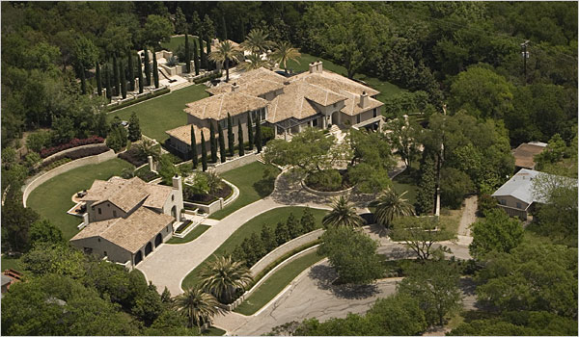
Lance Armstrong’s lush Spanish-colonial home, with an acre of gardens and a swimming pool. His consumption in July 2008 was 330,000 gallons water, the highest in Austin Texas.

Slide 9
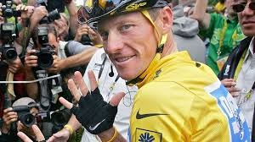
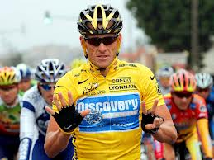
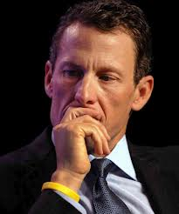
Lance Armstrong had won the Tour de France a record seven consecutive times between 1999 and 2005,
He was disqualified from each of those races and banned from cycling for life for doping offenses by the United States Anti-Doping Agency (USADA) in 2012.

Slide 10
A few questions
How much water do we need?
Are there substitutes for water?
Could something else besides water satisfy any of the uses of water?
Later on.
Basketball can be a substitute for water.

Slide 11
Champion Cyclist and Now Champion Guzzler of Austin Water
Lance Armstrong Uses More Water Than Anyone Else in the World (or at least in Austin, Texas).
"I need to fix this," Armstrong said of his 330,000 gallon water spree. "To use that much more water (than most residents) is unacceptable.”

Slide 12
Water shortage in New York City
How can we solve a severe water shortage problem in a big city?
Economist:
Use the price mechanism; raise the price of water.
Non-economist:
Water is a necessity. People won’t go thirsty just because the price of water goes up a little, or even a lot.

Slide 13
Substitutes for water in New York City
dirty cars
brown lawns
bricks in the toilet tank
low-flow shower heads
plumbers
migration

Slide 14
The trick is to …
persuade people to use these substitutes.
Higher prices achieve that.

Slide 15
How much water does the average person use at home? (US, per day)
Estimates vary, but the average American uses about 75 gallons of water per day, even though the estimated humanitarian need for water (sanitation, cooking, and cleaning) is about 13 gallons per day per person.
http://www.epa.gov/OW-OWM.html/cwfinance/cwsrf/consrvprice.pdf
The largest use of household water is to flush the toilet, and after that, to take showers and baths.

Slide 16
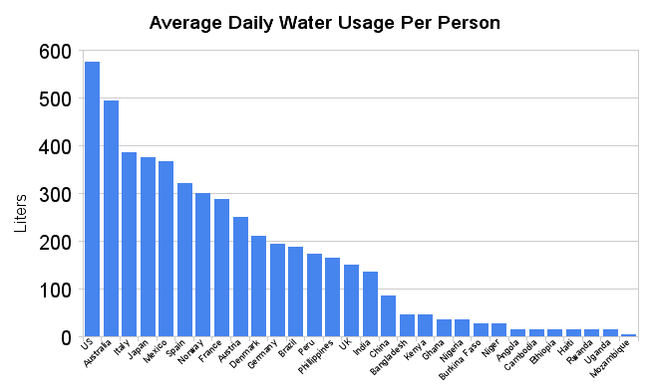

Slide 17
Again: need versus demand
The non-economist thinks of the demand for water as "the amount of water we need" and assumes that the alternative to having that amount of water is people going thirsty.
But only a tiny fraction of the water we consume is drink.
While the demand for drinking water may be highly inelastic over a wide range of prices, demand for other uses is not.

Slide 18
Fact List
80 to 90 percent of all water used is used in agriculture.
Crops like sugar cane, alfalfa, and fruit require farmers to use great amounts of water, but farmers who can get water at low prices prefer to grow such crops because they bring higher prices than other crops.
Some farmers grow rice in southern California. Southern California is extremely arid (some people would call it a desert), and water there evaporates rapidly. Rice grows in paddies that the farmers flood with water from huge irrigation canals.

Slide 19
If the price of water doubles,
it pays farmers to use water more sparingly for irrigation,
it pays the chemical firms to use less of it in their manufacturing processes, and
it pays the homeowners to fix leaky faucets.
Nobody dies of thirst, but total consumption of water falls a lot.

Slide 20
Fact List
Typical crop irrigation projects are less than 50 percent efficient. More than half of the water used for crop irrigation runs off or evaporates.
About one third of the water pumped into irrigation ditches soaks into the ground or evaporates.
Evaporation can be reduced by lining irrigation canals with cement, covering ditches with plastic, and by installing drip irrigation, which delivers water directly to each plant through tiny hoses.

Slide 21
Fact list
Farmers in the United States pay one fifth of the true cost of irrigating their crops with water from federal water projects. (The rest is subsidized—paid for by the government.)
Water is thus relatively inexpensive for farmers.
Studies show that a 10 percent increase in the price of water would cause farmers to use 5 to 6.5 percent less water;
The price increase will make them switch to better irrigation technology and/or grow crops that use less water.

Slide 22
Shortages everywhere!
To most non-economists, a shortage is a fact of nature--there just isn't enough.
To an economist, it has almost nothing to do with nature.
Diamonds are in very short supply--yet there is no diamond shortage.
Water is very plentiful; the average American consumes, directly or indirectly, more than 1000 gallons (about 4 tons) per day.
Yet we see water shortages.

Slide 23
Demand is not need
The mistake is in assuming that "enough" is a fact of nature--that we need a particular amount of land, water, diamonds, oil, or whatever.
In fact, the amount we choose to consume (and that producers choose to produce) depends on the price;
what we think of as our "need" is usually our quantity demanded at the price we are used to paying.

Slide 24
Last slide on “demand is not need”!
The question of how much choice individuals really have is about how flexible the economy as a whole is--to what extent it can change the amount of the different resources it uses.
We look at the way things are now being done and assume that that way is the only possible one.
But the way things are now done is the solution to a particular problem--producing goods as cheaply as possible given the present cost of various inputs.
If some input--unskilled labor, or energy, or some raw material--were much more or less expensive, the optimal way of producing would change.

Slide 25
In class activity (puzzle)
When is a basketball a substitute for (an alternative to) water?
In the summer when the city decides it is too expensive to fill the swimming pool, or your mom says the water bill is too high and, no, your little brothers and sisters can't play with the hose.
Now answer the following:
When is a basketball a substitute for (an alternative to) gasoline?
Give an example of an unlikely pair of goods (like water and basketballs) that can be substitutes.
Give an example for a “stupid,” or “immoral” water use. You can be (you must be) entirely subjective and unscientific.

Slide 26
All Scarce Goods Must Be Rationed Somehow
Market prices and willingness to pay are our primary criteria for rationing goods and services.
If a good is scarce, sacrifices must be made to obtain it.
When prices of products and services rise, people respond by economizing in their use.
People find ways to economize that brings the smallest sacrifice.

Slide 27
All Scarce Goods Must Be Rationed Somehow
Scarce goods must be rationed.
Rationing can be done by willingness to pay prices.
Other ways to ration:
Beauty
Seniority
“Fist come, first served”
Lottery
Equal shares for all
“Might makes right”
Merit

Slide 28
Demand and Supply – Theory
web link to the book chapter
http://www.cengage.com/economics/mankiw/samplechapter/Mankiw6e_Econ_Ch04.pdf
(publisher’s website)

Slide 29
This is perhaps the most important chapter in the textbook.
Learn this chapter well!
This is also one of the longest chapters in the textbook.
This PowerPoint file is one of the most graph-intensive.

Slide 30
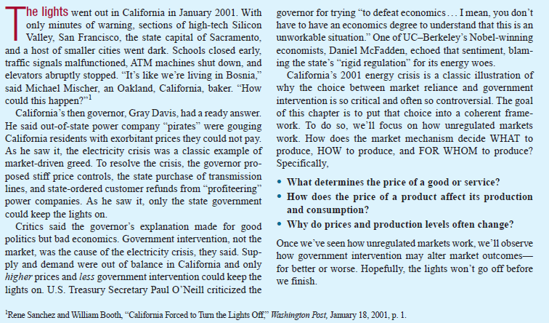

Slide 31
MARKETS AND COMPETITION
A market is a group of buyers and sellers of a particular good or service.
The terms supply and demand refer to the behaviour of people . . . as they interact with one another in markets.
Notes:
4

Slide 32
MARKETS AND COMPETITION
Buyers determine demand.
Sellers determine supply.
Notes:
4

Slide 33
Markets and Competition: A few definitions
0
A perfectly competitive market is one with many buyers and sellers, so that each individual has a negligible (very small) effect on price. In a perfectly competitive market all firms produce goods that are exactly the same.
Notes:
33

Slide 34
Competition: Perfect and Otherwise
Perfect Competition
Products are the same
Numerous buyers and sellers so that each has no influence over price
Buyers and Sellers are price takers
Monopoly
One seller, and seller controls price
Notes:
6

Slide 35
Competition: Perfect and Otherwise
Oligopoly
Few sellers
Not always aggressive competition
Monopolistic Competition
Many sellers
Slightly differentiated products
Each seller may set price for its own product
Notes:
6

Slide 36
Supply and Demand (or Demand and Supply)
Supply and demand are the two words that economists use most often. Supply and demand are the forces that make market economies work. Modern economics is about supply, demand, and market equilibrium.
Notes:
2

Slide 37
Demand - Theory
Now let’s introduce a few terms and definitions

Slide 38
The textbook definition of demand
Demand is a relationship between two variables: Price and the quantity demanded.
The quantity demanded of a good is the amount that buyer(s) are willing and able (have the resources –money) to purchase.

Slide 39
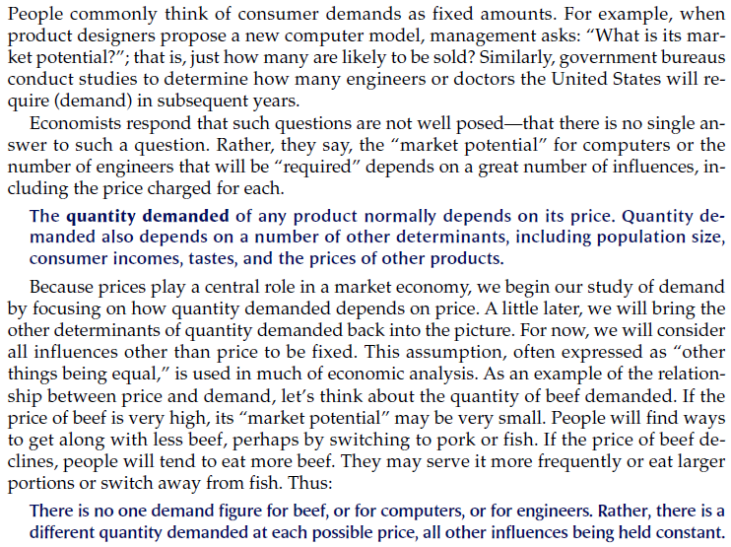

Slide 40
Demand
Demand is a relationship between two specific variables: Price and quantity demanded
while a number of other relevant variables are kept constant
Consumer’s income
Price of related goods (substitutes and complements)
Tastes
Expectations
Quantity demanded of a good is the amount of that good that buyers are willing and able to purchase.

Slide 41
Demand
The demand curve gives the relationship between price and quantity demanded, assuming that all other determinants of quantity demanded are kept constant.
The Law of Demand: Other things being equal, the quantity demanded of a good rises when the price of the good falls.
Remark: A change in the price of a good will cause a change in the quantity demanded of that good, but will not cause a change in the demand for that good.

Slide 42
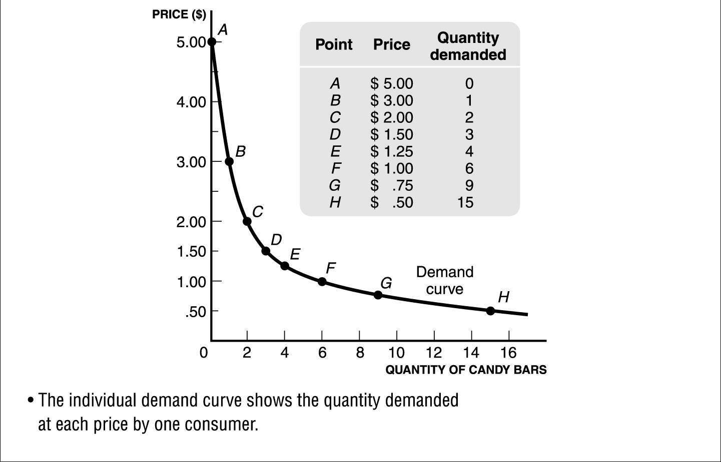
Demand
The individual demand curve shows the quantity demanded at each price by one consumer.

Slide 43
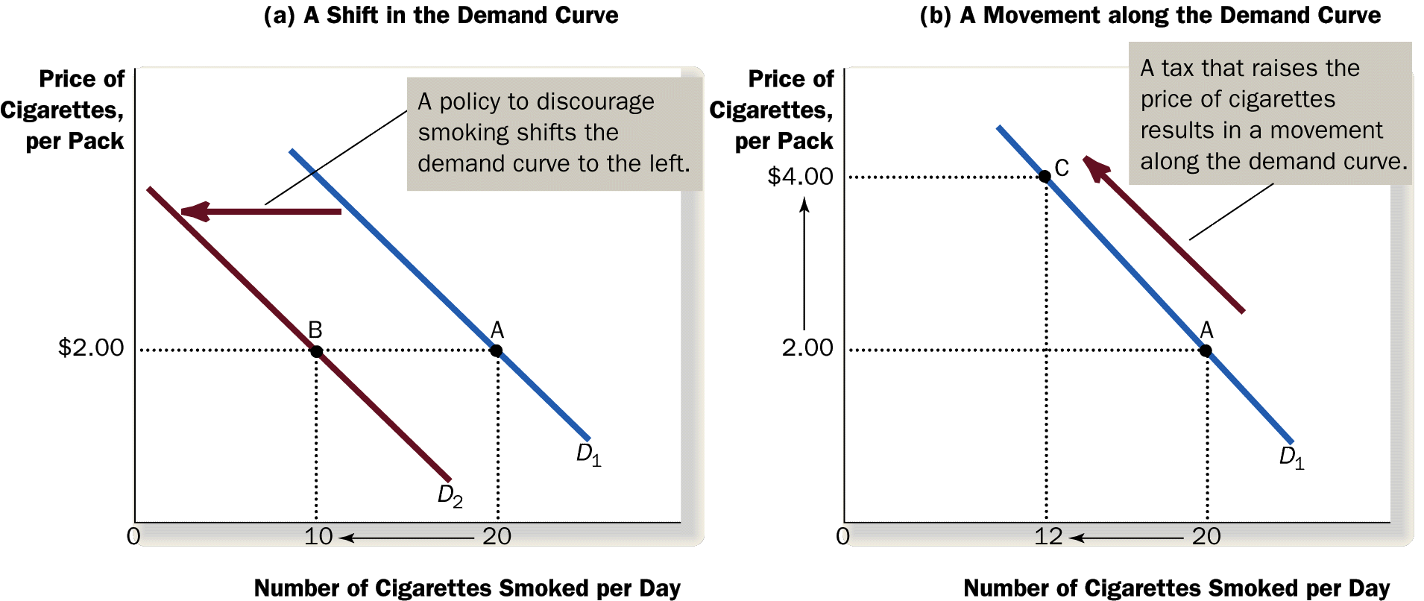
Demand
A change in the price of a good will cause a change in the quantity demanded of that good, but will not cause a change in the demand for that good.

Slide 44
Shifts in the Demand Curve
Consumer Income
As income increases, the demand for a normal good will increase.
As income increases, the demand for an inferior good will decrease.
Normal Good: e.g. meat
Inferior Good: e.g. bread
P
P
-
$3.00
An increase
$3.00
2.50
in income...
2.50
An increase
2.00
Increase
2.00
in income...
in demand
1.50
1.50
Decrease
in demand
1.00
1.00
0.50
D
2
0.50
D
1
D
2
D
1
Q
0
1
2
3
4
5
6
7
8
9
10
11
12
Q
0
1
2
3
4
5
6
7
8
9
10
11
12
-

Slide 45
Shifts in the Demand Curve
Prices of Related Goods
When a fall in the price of good X reduces the demand for good Y, these two goods X and Y are called substitutes.
Example: Ipad and labtop are substitutes. Suppose the price of Ipad decreases.
Ipad market
P
Labtop market
P
-
$3.00
$3.00
2.50
2.50
A
2.00
2.00
1.50
Decrease
1.50
in demand
1.00
1.00
B
0.50
0.50
D
1
D
2
D
1
-
0
1
2
3
4
5
6
7
8
9
10
11
12
Q
0
1
2
3
4
5
6
7
8
9
10
11
12
Q

Slide 46
Shifts in the Demand Curve
Prices of Related Goods
When a fall in the price of good X increases the demand for good Y, these two goods X and Y are called complements.
Example: DVD and DVD player are complements. Suppose the price of DVD’s decreases.
DVD market
DVD player market
P
-
P
$300
$30
250
25
A
200
22
150
Increase
15
in demand
10
100
B
5
50
D
1
D
2
D
1
-
0
1
2
3
4
5
6
7
8
9
10
11
12
Q
0
1
2
3
4
5
6
7
8
9
10
11
12
Q

Slide 47
Question: What is the effect of these events on the demand for small cars?
Small cars become more fashionable.
The price of large cars rises (the price of small ones is the same).
Income declines (small cars are an inferior good).
A big decrease in the price of gasoline.

